Slide 1


Multi-physics Design Optimization of a GaN Based Integrated Modular Motor Drive System
The 9th International Conference on Power Electronics, Machines and Drives
Mesut Uğur
mesut.ugur@metu.edu.tr
Department of Electrical and Electronics Engineering
Middle East Technical University
19.04.2018

Slide 2

Outline
Motivation
System model
Evaluation with design parameters
Optimum system design
Conclusions
References

Slide 3
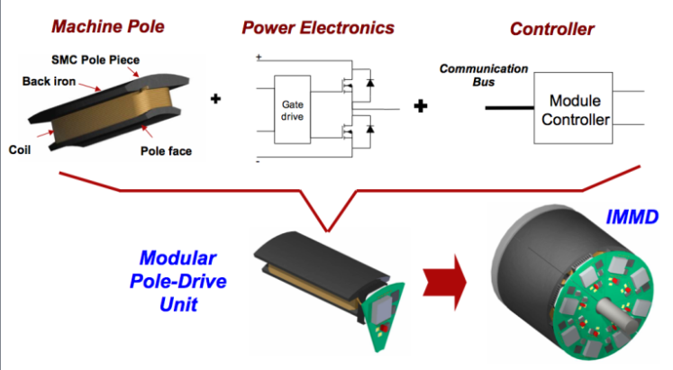
Motivation
Integrated Modular Motor Drive
Increased power density
Reduced cost
Reduced EMI
Fault tolerance
Redundancy
Reduced stress
Shea, A., & Jahns, T. M. (2014). Hardware integration for an integrated modular motor drive including distributed control. In 2014 IEEE Energy Conversion Congress and Exposition (ECCE) (pp. 4881–4887). IEEE.

Slide 4
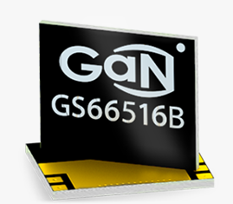
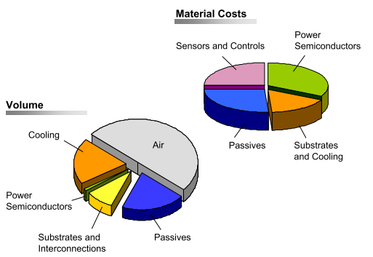
Motivation
Design Challenges
Limited space available
Inter-dependencies between parts
Thermal management
Design optimization
Careful layut design
Detailed modeling

Slide 5
System Model

Slide 6
System Model
Effect of interleaving

Slide 7
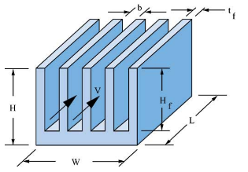
System Model

Slide 8
System Evaluation

Slide 9
System Evaluation

Slide 10
System Evaluation

Slide 11
System Evaluation

Slide 12
Optimum System Design
Number of series connected modules (n_{s}): 2
Voltage rating of GaNs
Modulation index (m_{a}): 0.9
Overmodulation
Number of parallel connected modules (n_{p}) : 2
Efficiency
Power density
Drive cost
Switching frequency (fsw): 50 kHz
Aspect ratio (α): 0.5
Slot/module/phase (w): 2
Tooth width

Slide 13
System Performance
Drive efficiency: 98.3 %
Motor efficiency: 96.6 %
Power density: 0.71 kW/lt
Motor material cost: 249.5 $
IMMD

Slide 14
References
[1] G. Lo Calzo, G. Vakil, B. Mecrow, S. Lambert, T. Cox, C. Gerada, M. Johnson, and R. Abebe, “Integrated motor drives: state of the art and future trends,” IET Electr. Power Appl., vol. 10, no. 8, pp. 757–771, Sep. 2016.
[2] M. D. Hennen, M. Niessen, C. Heyers, H. J. Brauer, and R. W. De Doncker, “Development and control of an integrated and distributed inverter for a fault tolerant five-phase switched reluctance traction drive,” IEEE Trans. Power Electron., vol. 27, no. 2, pp. 547–554, 2012.
[3] J. Wang, Y. Li, and Y. Han, “Integrated Modular Motor Drive Design With GaN Power FETs,” IEEE Trans. Ind. Appl., vol. 51, no. c, pp. 3198–3207, 2015.
[4] M. Ugur and O. Keysan, “DC link capacitor optimization for integrated modular motor drives,” 2017 IEEE 26th Int. Symp. Ind. Electron., vol. i, pp. 263–270, 2017.
[5] A. Shea and T. M. Jahns, “Hardware integration for an integrated modular motor drive including distributed control,” in 2014 IEEE Energy Conversion Congress and Exposition (ECCE), 2014, pp. 4881–4887.
[6] N. Bekka, M. E. H. Zaim, N. Bernard, and D. Trichet, “A Novel Methodology for Optimal Design of Fractional Slot with Concentrated Windings,” IEEE Trans. Energy Convers., vol. 31, no. 3, pp. 1153–1160, 2016.
[7] GaN Systems, “GaN Systems.” [Online]. Available: http://www.gansystems.com/. [Accessed: 15-Jan-2018].
[8] TDK, “Film Capacitors, Metallized Polypropylene Film Capacitors (MKP) - B32674...B32674 Datasheet,” no. May. 2015.
[9] R. E. Simons, “Estimating Parallel Plate-Fin Heat Sink Thermal Resistance.” [Online]. Available: https://www.electronics-cooling.com/2003/02/estimating-parallel-plate-fin-heat-sink-thermal-resistance/.

Slide 15


Thank you !
Mesut Uğur
mesut.ugur@metu.edu.tr
Department of Electrical and Electronics Engineering
Middle East Technical University
power.eee.metu.edu.tr

